Slide 1
Drama Genre
Secret life of walter mitty

Slide 2
The film
The film version of The Secret Life Of Walter Mitty, starring Ben Stiller and Kristen Wiig, was entirely based on the short story of the same name, written by James Thurber, so there is bound to be some connections between them. The largest and most obvious one is the multitude of daydreams that Walter has throughout both pieces of work. Though the dreams are different in content, the constant repetition of them are very close to the same, at least until the final scenes of the movie. The distinction between Walter’s reality and his wild imagination is not always clear in either version of the story, really demonstrating the closeness between the two mediums

Slide 3
The short story
In the short story, this interaction occurred between Walter and Mrs.Mitty, when he asked her “Does it ever occur to you that I am sometimes thinking?” For a moment, it seems like he is going to continue on speaking and explain to Mrs.Mitty how he daydreams, but this sadly does not happen. In the film, this moment is referenced when Walter seriously considers telling Cheryl that he got a longboard as a present for her son, but after thinking about it, he decides to keep it to himself.

Slide 4
Film and short story
There are many similarities and differences between The Secret Life Of Walter Mitty short story, and the film adaptation. Both versions of the work have some of the same characteristics, such as the constant switching between reality and imagination, and plenty of differences, such as the ending being completely different. The film also had quite a few moments that made reference to the short story in indirect, and sometimes amusing ways.

Slide 5
Production
Conflict:Walters dreams are creating problems between him and others because of the way he is act in his fantasies.
Character: Walter mitty is a creative imaginative person who works as a negative assets manager for the life magazine
The setting - the story takes place in a New York and in the mind of Walter

Slide 6
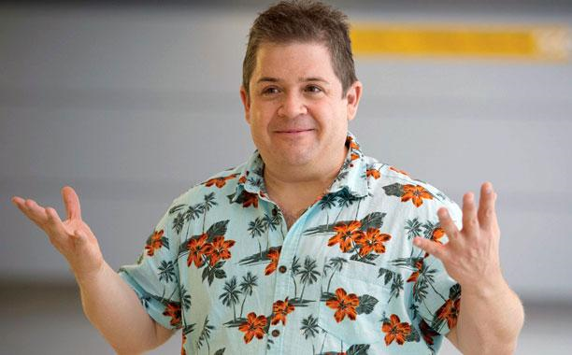
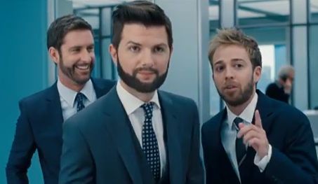
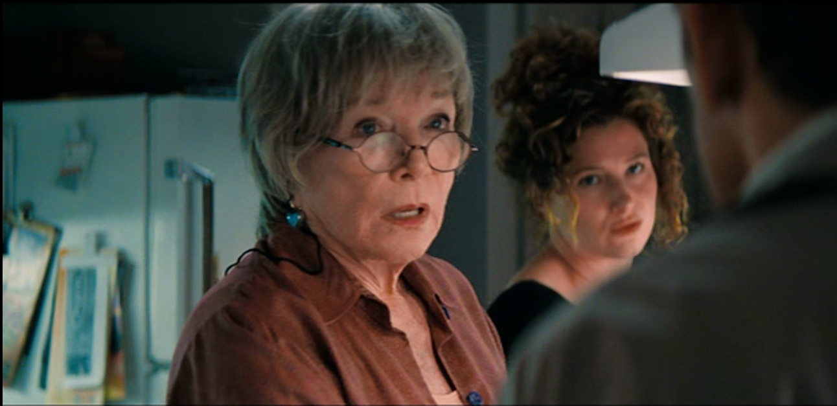
Character archetypes
Hero: Ben stiller(Walter) Helper: Patton Oswalt(Todd) Damsel:Kristen Wiig(Cheryl)
Villain: Adam Scott (Ted) Mentor: Shirley MacLaine(Enda)

Slide 7
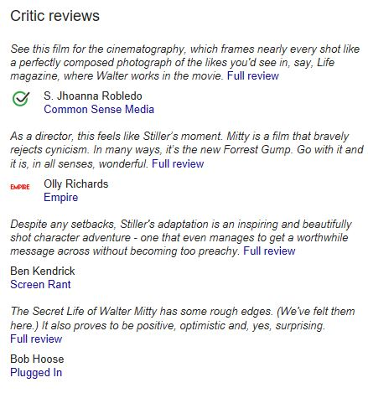
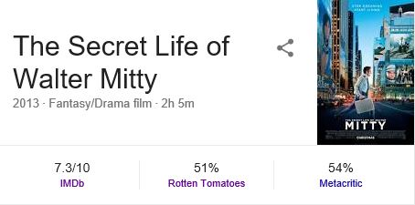
info

Slide 8
About the film
Narrative and plot:
"The Secret Life of Walter Mitty" is told by an uninvolved third person narrator, though that point of view is limited to Walter Mitty. We follow Mitty through his day, and we only get to see or know the things that Mitty himself sees or knows. (You might also have heard the term "implied indirect discourse, which is also a legit name for it.) What this means is that, though the point of view is indeed third person, Walter Mitty's character extends a sort of influence over the narration. The words that are chosen have more to do with Mitty's mindset than they do with objective narration

Slide 9
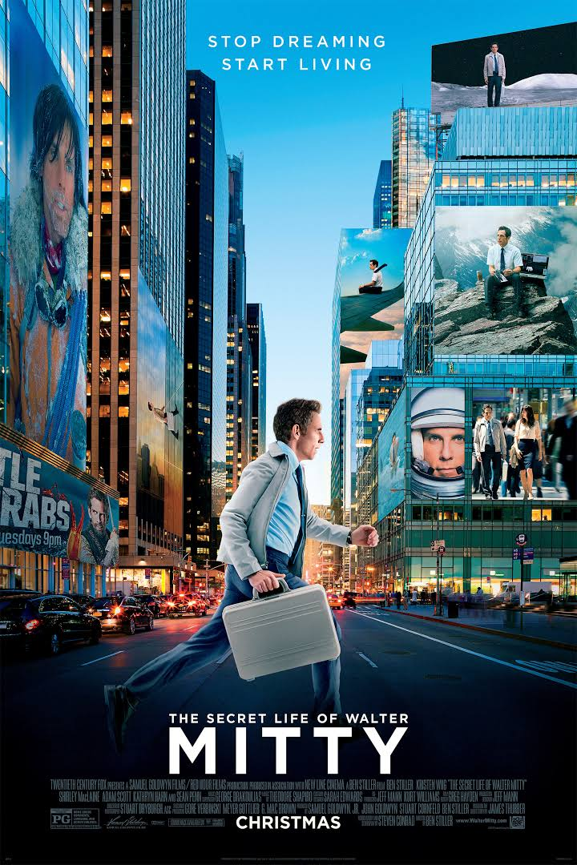
Advertising campaign
This advertising poster which shows a few important features to the story of the movie:
The photo that is used in the poster shows you walter and the imaginary world around him.
In the front we see walter rushing to work and in the background we see that walter imagination is every.

Slide 10
Conclusion
“Go with it and it is, in all senses, wonderful”
This quote from Empire’s Olly Richards perfectly sums up this film for me. You need to let it tell it’s story and enjoy being part of the journey in order to appreciate how wonderful it is. A unique and modern piece of artistry.

