Slide 1
MY MEDIA STORY

Slide 2
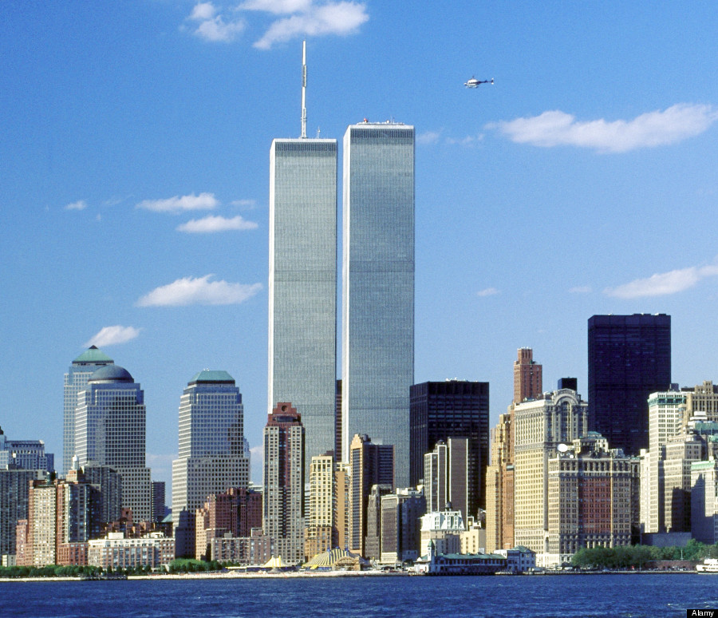
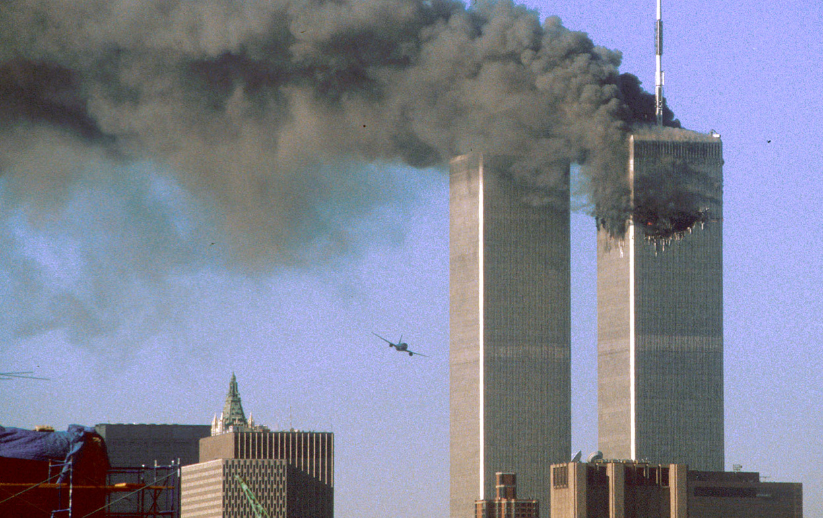
9/11
THE 9/11 attacks on the World Trade complex in New York and the Pentagon took place over 13 years ago.
Nearly 3,000 people were killed, 400 were police officers and firefighters, in the terrorist attacks at the World Trade Center in NYC, at the Pentagon building in Washington, D.C., and in a plane crash near Shanksville, PA.
9/11 was not the first terrorist attack on the World Trade Center. A bombing in February of 1993 killed six people.

Slide 3
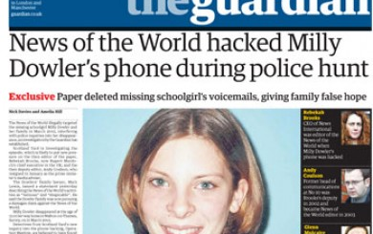
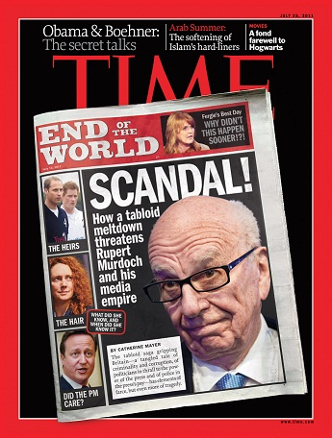
The phone Hacking scandal

Slide 4
Netflix was founded in 1997 in Scotts valley, California.
The Netflix website was launched on August 29, 1997 with only 30 employees and 925 works available for rent through a traditional pay-per-rental model.
In February 2007, the company delivered its billionth DVD and began to move away from its original core business model of mailing DVDs by introducing video on demand via the internet.
Netflix grew as DVD sales fell from 2006 on.

