Slide 1
CODES AND CONVENTIONS OF FACTUAL PROGRAMMING FOR TELEVISION
Ciaran McElhinney

Slide 2
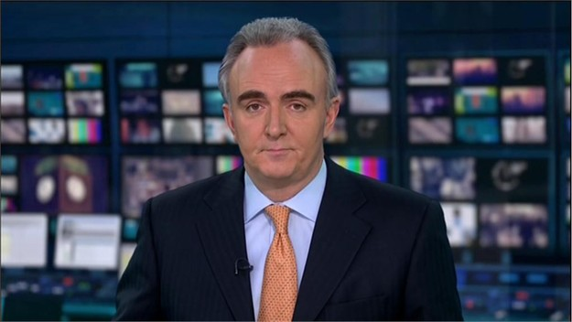
THE NEWS STUDIO
A formal environment
Sleek. stylish and minimal set
Presenters are smartly dressed in suits or business style
Presenters are usually seated and looking directly into the camera
Facts are often displayed in the background to underpin what is being said
The language used is factual and direct stating specific facts, a sequence of events or overview of an event.

Slide 3
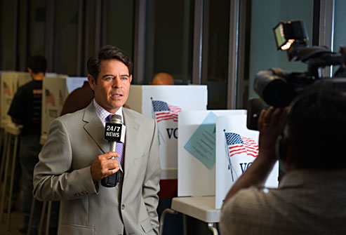
FIELD REPORTS
News items are often reinforced by reports from the field
Field reporters are filmed at the scene of an event
They will provide more in depth knowledge of a story
Footage at the sight of a story enhances the value of the report
This bring for insight and depth to the story and provides the viewer with factual and visual details

Slide 4
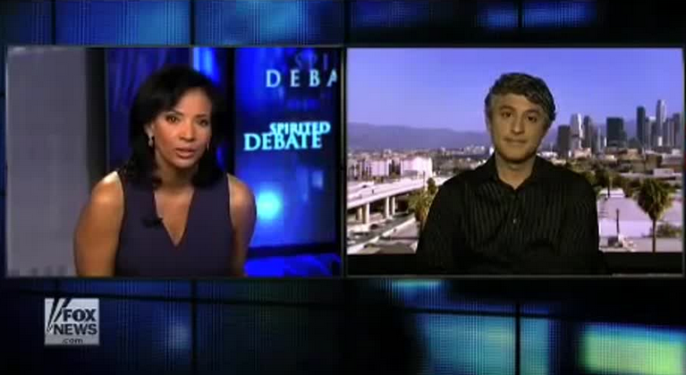
LINKS TO STUDIO
The ability to link field reporter and the studio presenter allows a discussion to take place
The studio based presenter will ask probing questions to gain a greater understanding of the event and clarify the facts which they have presented.
It is also possible to discuss sequence of events, the moods and excitement at the scene and often to get more up to the minute details as stories unfold.

Slide 5
MODE OF ADDRESS TO VIEWER
News programmes try to make personal connections with the viewers using their mode of address.
A welcome message is often included at the beginning of the show. This gives the impression that the presenter is pleased to have the viewers attention and values that they have taken time to tune in.
Another personal address is often included at the end of the bulletin, evening bulletins may wish the viewer a pleasant evening or ask them to take care if travelling in bad weather.
They will also often invite the viewer to return and tune in to the next bulletin.

Slide 6
INTERVIEWING AND THE USE OF EXPERTS AND WITNESSES
Interviewing key players during factual news programmes adds depth to a story and allows experts to provide knowledge and specific data to the audience
An economist can provide key facts about budget changes for instance or a scientist about a particular scientific breakthrough.
The presenter may not be an expert in all areas and the interviewing process allows for input from those with specialist knowledge and therefore enhances the presentation

Slide 7
REPORT STRUCTURE
News reports often begin by introducing a topic and giving a short overview of the facts relating to an event
The report may include a field report which will provide at the scene reports to clarify and enhance the initial introductions
Links between the studio reporter and the field reporter allow for interactions and the studio reporter often asks probing questions to develop the story and build a picture of what is happening
Interviewing studio guests can further gain clarity and detail about a particular story. This type of reporting is often used when reporting on sporting events such as The World Cup
The report usually end with a short summary of the event and what is expected to happen next

Slide 8
ACTUALITY FOOTAGE
Actual footage of events as they happen is often used in news presentation.
Events such as marches, commemorations, state visits and even sporting events use actual footage to reinforce the news story
Events such as The Grand National are widely reported and actual footage of the event often used as part of the news programme after the race
Actual footage of an event is often edited to fit into a shorter time frame but not manipulated to influence the viewer or benefit a specific bias

Slide 9
DOCUMENTARY FORMATS
The documentary is a nonfiction piece of film intended to provide information about some aspect of reality, primarily for the purposes of instruction or maintaining a historical record.
The documentary is usually subject specific and unlike a news report can document the events over a longer term and provide more in depth information about a particular subject
A documentary uses a variety of techniques to tell a story that will engage and entertain the audience are a longer period than the news bulletin

Slide 10
EXPOSITORY DOCUMENTARIES
Expository documentaries are documentaries that expose a person or a topic, a classic form of documentary
Expository documentaries are well known for having a commentator, talking over the pictures or videos and explaining the story
In an these documentaries the commentator talks specifically to the audience. They are often biographical, historical or talk about a certain event.
They include footage, Interviews or pictures exclusive to the documentary

Slide 11
OBSERVATIONAL DOCUMENTARIES
Observational documentaries attempt to simply and spontaneously observe lived life with a minimum of intervention.
The first observational docs date back to the 1960s; the technological developments which made them possible include mobile lightweight cameras and portable sound recording equipment for synchronized sound.
Often, this mode of film avoided voice-over commentary, post-synchronized dialogue and music, or re-enactments.
The films aimed for immediacy, intimacy, and revelation of individual human character in ordinary life situations.

Slide 12
INTERACTIVE DOCUMENTARIES
The integration of a combination of multimedia assets (photos, text, audio, animation, graphic design, etc.) with new technologies. In a interactive documentary the user has to interact with, or navigate through, the story
These documentaries are often used in modern museums such as Titanic Belfast.
They benefit the viewer by engaging them in the story and leading them through it in a more sensual manner than the observational documentary

Slide 13
REFLEXIVE DOCUMENTARIES
Reflexive documentaries use re enactments and techniques from fictional films usually adding dramatic music too.
They rely more on suggestion than fact.

Slide 14
PERFORMATIVE DOCUMENTARIES
The documentary maker and crew interact with the subject they are filming.
The audience will be addressed in an emotional and direct way and will be given the option to chose how they feel about the subject.

Slide 15
Realism - The documentary contains actual film footage taken from a scene or event of the subject matter Often this is interviews with witnesses and recorded phone discussions as well as photos.
Dramatization - Here a producer will dramatize a story and spice it up to make it more watchable and interesting. These are frequently reconstructions of an occasion or story.

Slide 16
Narrativisation is the telling of story in narrative form. The tone of the narrative can be used to influence the viewer and increase the intensity and dramatization of the story.

