Slide 1
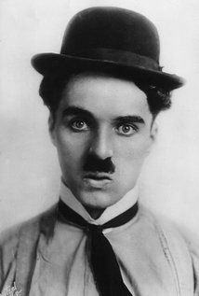
Film Auteur
Charles Chaplin

Slide 2
What is an auteur
The French word ‘Auteur’ denotes film directors with a stamped personal style and influence over all the elements of a film, holding sway over the entire artistic control of the film. It is quite apparent that some filmmakers are more diversified and does not fit into the definition. Infact only a handful of directors could theoretically be ever considered a true auteur. The theory establishes firmly that a director of the film could be affirmatively compared to an author of a book. Like how a writer authors a book, similarly- a director could author a movie.

Slide 3
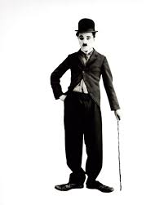
Who is he
Sir Charles Spencer "Charlie" Chaplin.
Charlie Chaplin, considered to be one of the most pivotal stars of the early days of Hollywood, lived an interesting life both in his films and behind the camera. He is most recognized as an icon of the silent film era, often associated with his popular character, the Little Tramp; the man with the toothbrush mustache, bowler hat, bamboo cane, and a funny walk.

Slide 4
Backstory
Impoverished as a child and forced to fend for himself, Charlie Chaplin began acting on stage at the age of 13. He toured the United States in vaudeville, and soon started performing in films and rose to fame with "The Champion," "A Night Out," and "The Tramp." He co-founded United Artists with Douglas Fairbanks, Mary Pickford, and D.W. Griffith and began directing his own films.
http://www.biography.com/video/charlie-chaplin-mini-biography-37472352

Slide 5
Early career
Moved to LA after signing a contract with keystone.
First featured in 1 reeler making a living.
Kid auto races in venice: tramps first appearance.
Chaplin’s first film as a director caught in the rain 1914 was a success
Left keystone after disagreements with sennett over his new contract.

Slide 6
Later career
Went to work for essanay around 1915 later worked for mutual film corporation, first national and united artists
Almost complete creative control
The tramp further developed as a character
Start to develop special effects
Built his own studio in 1918
Began releasing films through united artists in 1923

Slide 7
Styles and technique
The main thing that are embedded in his films is humer
Physical comedy
Exaggerated facial expressions
He's the main focus of the show
Sympathy from an audience

Slide 8
His work examples
https://www.youtube.com/watch?v=79i84xYelZI
https://www.youtube.com/watch?v=dLyd7v0RwNI
https://www.youtube.com/watch?v=Jf25OYtBhFM

Slide 9
Chaplins transition to sound
The rest of the industry had long left silent behind, and in his autobiography he explains, “To continue with a feeling that the art of pantomime was gradually becoming obsolete was a discouraging thought.” On the other hand, he worried, “If I talked I would become like any other comedian.” Then Hitler came to the rescue:
“Alexander Korda in 1937 had suggested I should do a Hitler story based on mistaken identity, Hitler having the same moustache as the tramp: I could play both characters, he said. I did not think too much about the idea then, but now it was topical, and I was desperate to get working again. Then it suddenly struck me. Of course! As Hitler I could harangue the crowds in jargon and talk all I wanted to. And as the tramp I could remain more or less silent. A Hitler story was an opportunity for burlesque and pantomime”.
http://www.newyorker.com/culture/richard-brody/charlie-chaplins-talking-pictures

Slide 10
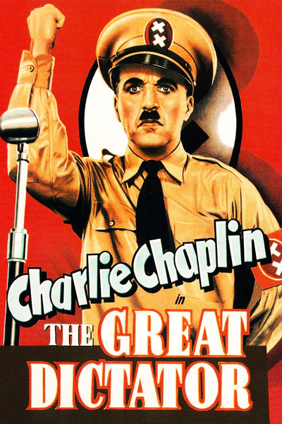
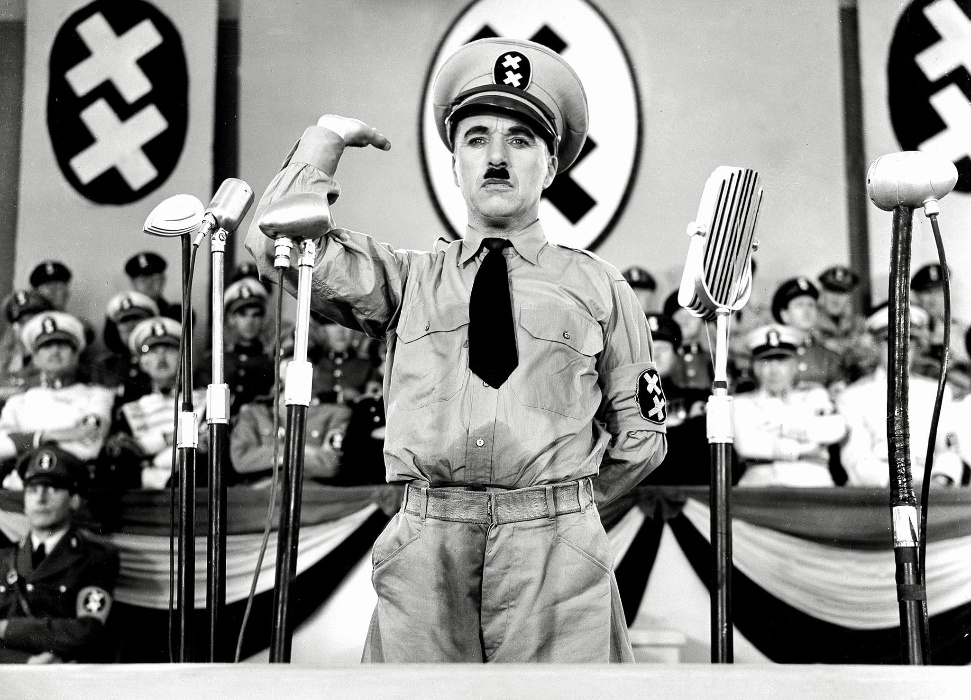
And then “The Great Dictator,” was born and was released in 1940

Slide 11
Conclusion
So in conclusion, by reference to the examples I have highlighted Charlie Chaplin’s influence in comedy films I believe I have demonstrated the usefulness of wider film readings as a critical tools for understanding and how meaning is created in comedy.
Charlie chaplin is the king of comedy

